Slide 1
Stack and Queue
COMP171
Fall 2005

Slide 2
Queue Overview
Queue ADT
Basic operations of queue
  Enqueuing, dequeuing etc.
Implementation of queue
  Array
  Linked list

Slide 3
Queue ADT
Like a stack, a queue is also a list. However, with a queue, insertion is done at one end, while deletion is performed at the other end.
Accessing the elements of queues follows a First In, First Out (FIFO) order.
  Like customers standing in a check-out line in a store, the first customer in is the first customer served.

Slide 4
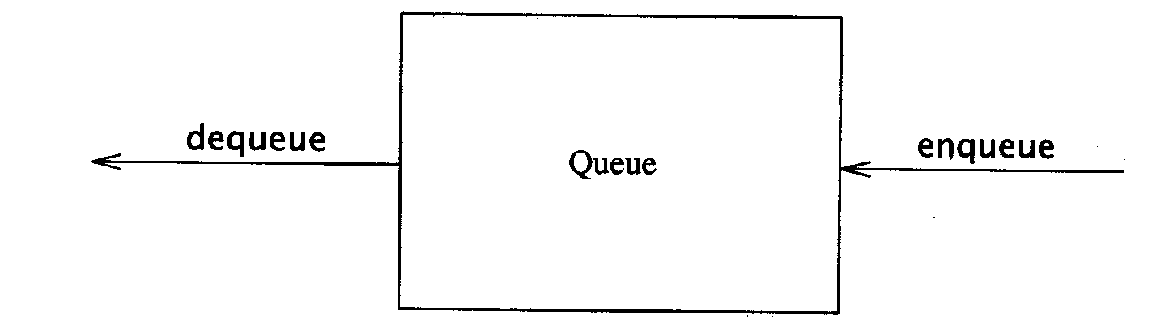
The Queue ADT
Another form of restricted list
  Insertion is done at one end, whereas deletion is performed at the other end
Basic operations:
  enqueue: insert an element at the rear of the list
  dequeue: delete the element at the front of the list
First-in First-out (FIFO) list

Slide 5
Enqueue and Dequeue
Primary queue operations: Enqueue and Dequeue
Like check-out lines in a store, a queue has a front and a rear.
Enqueue
  Insert an element at the rear of the queue
Dequeue
  Remove an element from the front of the queue
Remove
(Dequeue)
Insert
(Enqueue)
front
rear

Slide 6
Implementation of Queue
Just as stacks can be implemented as arrays or linked lists, so with queues.
Dynamic queues have the same advantages over static queues as dynamic stacks have over static stacks

Slide 7
Queue Implementation of Array
There are several different algorithms to implement Enqueue and Dequeue
Naïve way
  When enqueuing, the front index is always fixed and the rear index moves forward in the array.
rear
rear
rear
3
3
6
3
6
9
front
front
front
Enqueue(3)
Enqueue(6)
Enqueue(9)

Slide 8
Queue Implementation of Array
Naïve way
  When enqueuing, the front index is always fixed and the rear index moves forward in the array.
  When dequeuing, the element at the front the queue is removed. Move all the elements after it by one position. (Inefficient!!!)
rear
rear
rear = -1
6
9
9
front
front
front
Dequeue()
Dequeue()
Dequeue()

Slide 9
Queue Implementation of Array
Better way
  When an item is enqueued, make the rear index move forward.
  When an item is dequeued, the front index moves by one element towards the back of the queue (thus removing the front item, so no copying to neighboring elements is needed).
(front)
XXXXOOOOO (rear)
OXXXXOOOO (after 1 dequeue, and 1 enqueue)
OOXXXXXOO (after another dequeue, and 2 enqueues)
OOOOXXXXX (after 2 more dequeues, and 2 enqueues)
The problem here is that the rear index cannot move beyond the last element in the array.

Slide 10
Implementation using Circular Array
Using a circular array
When an element moves past the end of a circular array, it wraps around to the beginning, e.g.
  OOOOO7963 → 4OOOO7963 (after Enqueue(4))
  After Enqueue(4), the rear index moves from 3 to 4.

Slide 11
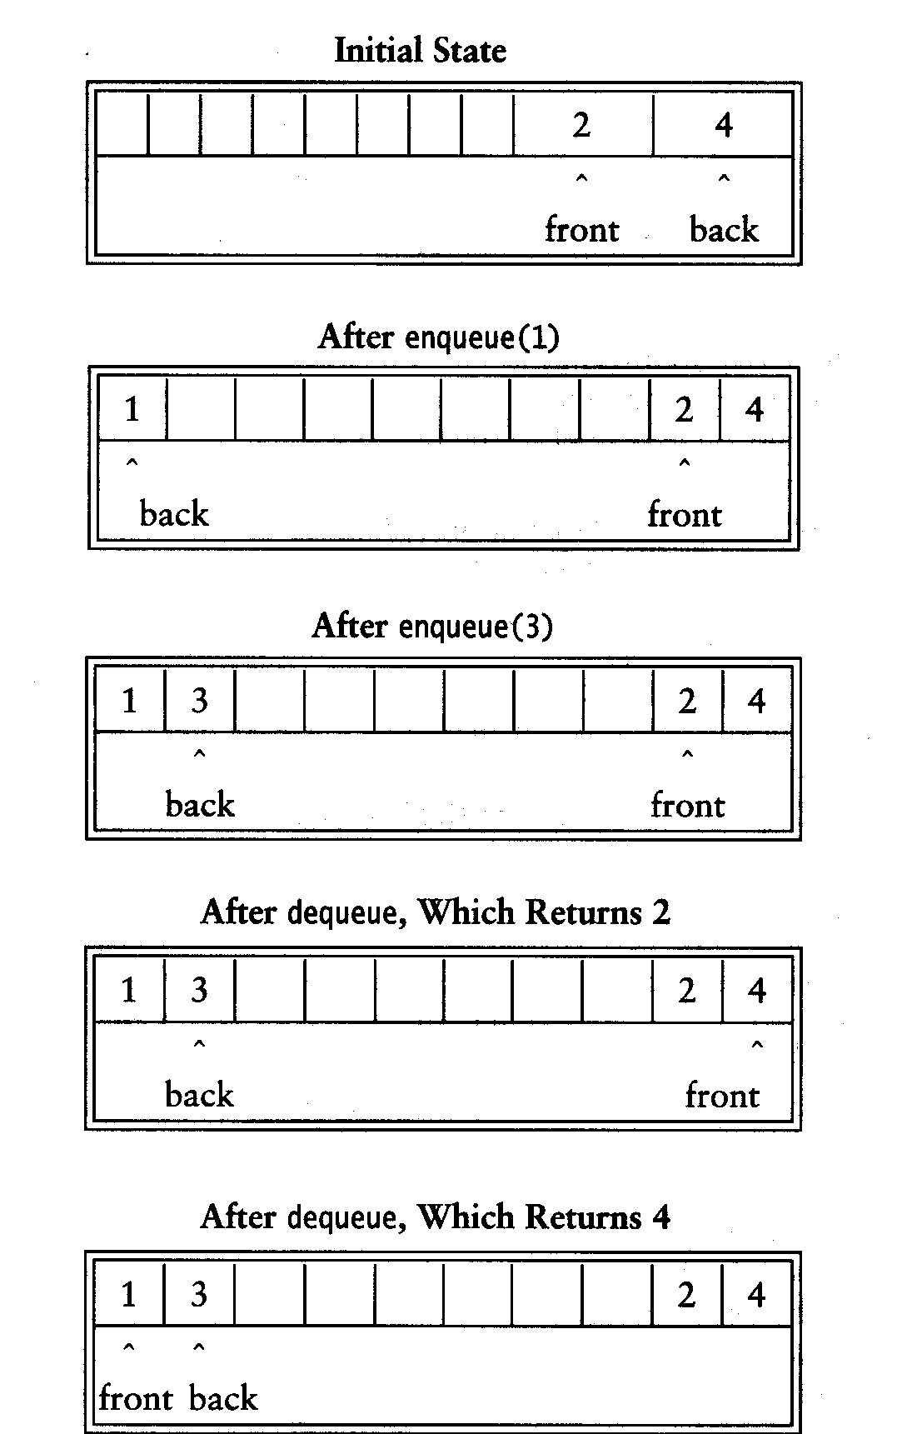
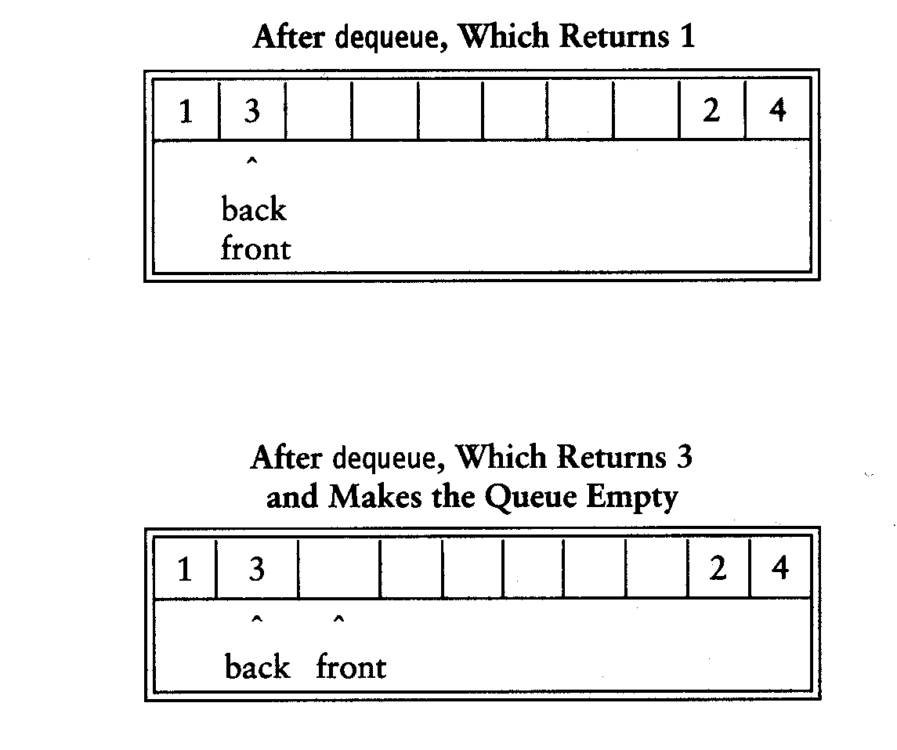

Slide 12
Empty or Full?
Empty queue
  back = front - 1
Full queue?
  the same!
  Reason: n values to represent n+1 states
Solutions
  Use a boolean variable to say explicitly whether the queue is empty or not
  Make the array of size n+1 and only allow n elements to be stored
  Use a counter of the number of elements in the queue

Slide 13
Queue Implementation of Linked List
class Queue {
public:
Queue(int size = 10); // constructor
~Queue() { delete [] values; } // destructor
bool IsEmpty(void);
bool IsFull(void);
bool Enqueue(double x);
bool Dequeue(double & x);
void DisplayQueue(void);
private:
int front; // front index
int rear; // rear index
int counter; // number of elements
int maxSize; // size of array queue
double* values; // element array
};

Slide 14
Queue Class
Attributes of Queue
  front/rear: front/rear index
  counter: number of elements in the queue
  maxSize: capacity of the queue
  values: point to an array which stores elements of the queue
Operations of Queue
  IsEmpty: return true if queue is empty, return false otherwise
  IsFull: return true if queue is full, return false otherwise
  Enqueue: add an element to the rear of queue
  Dequeue: delete the element at the front of queue
  DisplayQueue: print all the data

Slide 15
Create Queue
Queue(int size = 10)
  Allocate a queue array of size. By default, size = 10.
  front is set to 0, pointing to the first element of the array
  rear is set to -1. The queue is empty initially.
Queue::Queue(int size /* = 10 */) {
values = new double[size];
maxSize = size;
front = 0;
rear = -1;
counter = 0;
}

Slide 16
IsEmpty & IsFull
Since we keep track of the number of elements that are actually in the queue: counter, it is easy to check if the queue is empty or full.
bool Queue::IsEmpty() {
if (counter) return false;
else return true;
}
bool Queue::IsFull() {
if (counter < maxSize) return false;
else return true;
}

Slide 17
Enqueue
bool Queue::Enqueue(double x) {
if (IsFull()) {
cout << "Error: the queue is full." << endl;
return false;
}
else {
// calculate the new rear position (circular)
rear = (rear + 1) % maxSize;
// insert new item
values[rear] = x;
// update counter
counter++;
return true;
}
}

Slide 18
Dequeue
bool Queue::Dequeue(double & x) {
if (IsEmpty()) {
cout << "Error: the queue is empty." << endl;
return false;
}
else {
// retrieve the front item
x = values[front];
// move front
front = (front + 1) % maxSize;
// update counter
counter--;
return true;
}
}

Slide 19

Printing the elements
void Queue::DisplayQueue() {
cout << "front -->";
for (int i = 0; i < counter; i++) {
if (i == 0) cout << "\t";
else cout << "\t\t";
cout << values[(front + i) % maxSize];
if (i != counter - 1)
cout << endl;
else
cout << "\t<-- rear" << endl;
}
}

Slide 20
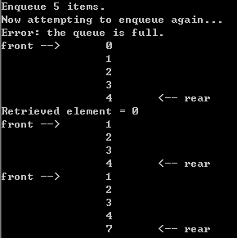
Using Queue
int main(void) {
Queue queue(5);
cout << "Enqueue 5 items." << endl;
for (int x = 0; x < 5; x++)
queue.Enqueue(x);
cout << "Now attempting to enqueue again..." << endl;
queue.Enqueue(5);
queue.DisplayQueue();
double value;
queue.Dequeue(value);
cout << "Retrieved element = " << value << endl;
queue.DisplayQueue();
queue.Enqueue(7);
queue.DisplayQueue();
return 0;
}

Slide 21
Enqueue
void Queue::Enqueue(double x) {
Node* newNode = new Node;
newNode->data = x;
newNode->next = NULL;
if (IsEmpty()) {
front = newNode;
rear = newNode;
}
else {
rear->next = newNode;
rear = newNode;
}
counter++;
}
rear
8
5
rear
8
5
newNode

Slide 22
Dequeue
bool Queue::Dequeue(double & x) {
if (IsEmpty()) {
cout << "Error: the queue is empty." << endl;
return false;
}
else {
x = front->data;
Node* nextNode = front->next;
delete front;
front = nextNode;
counter--;
}
}
front
3
8
5
front
8
5

Slide 23
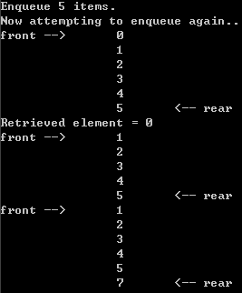
Printing all the elements
void Queue::DisplayQueue() {
cout << "front -->";
Node* currNode = front;
for (int i = 0; i < counter; i++) {
if (i == 0) cout << "\t";
else cout << "\t\t";
cout << currNode->data;
if (i != counter - 1)
cout << endl;
else
cout << "\t<-- rear" << endl;
currNode = currNode->next;
}
}

Slide 24
Result
Queue implemented using linked list will be never full
based on array
based on linked list

